Slide 1
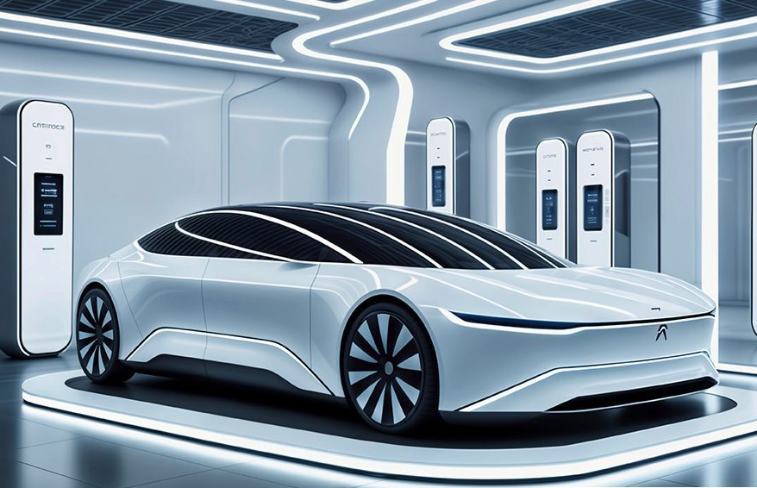
"Optimizing EV Charging Infrastructure: A Data-Driven Approach for Washington"
Juan Carpio
DA13 Cohort
Nashville Software School
March 2025

Slide 2



Objective: Design a strategy for efficient EV charging station distribution.
Approach: Analyze public data and model infrastructure placement. Geographic location (latitude/longitude) Number of registered EVs Number of charging stations and chargers
Challenges: Data integration, effective modeling, and clear visualization.

Slide 3
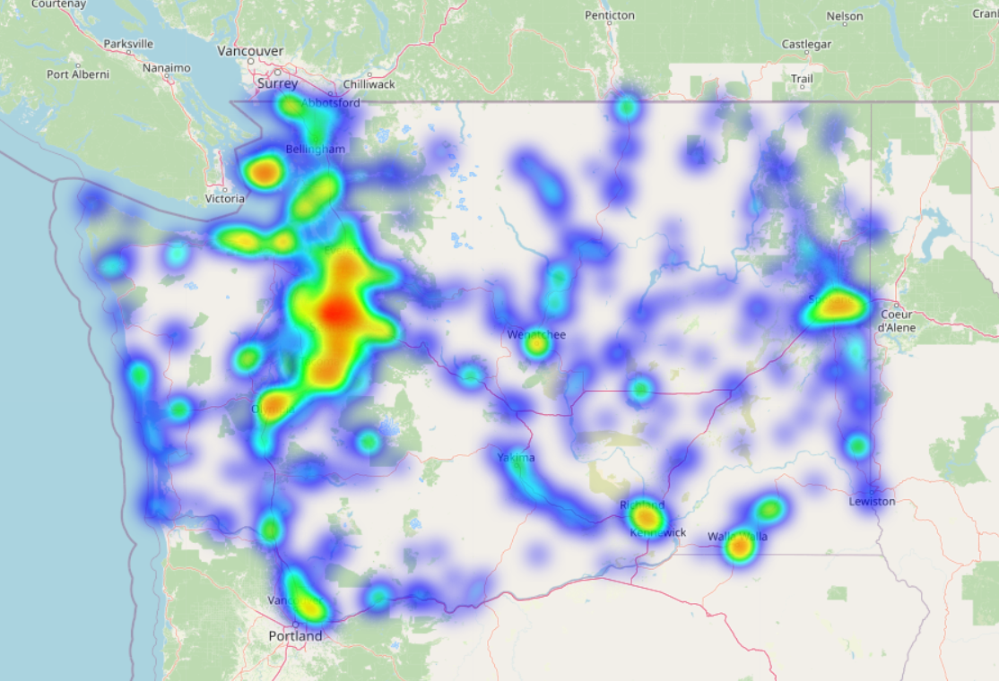
Problem Overview The increasing adoption of electric vehicles (EVs) in Washington presents both opportunities and challenges for infrastructure planning. While EVs contribute to reducing carbon emissions and reliance on fossil fuels, their widespread adoption is hindered by limitations in charging infrastructure. *Uneven Distribution of Charging Stations *Infrastructure Deficit in High-Growth Areas *Challenges in Strategic Station Placement *Need for Data-Driven Decision-Making Goal This project aims to analyze EV distribution and charging station availability in Washington to identify gaps, optimize placement, and provide recommendations for a more efficient and accessible EV charging network.

Slide 4
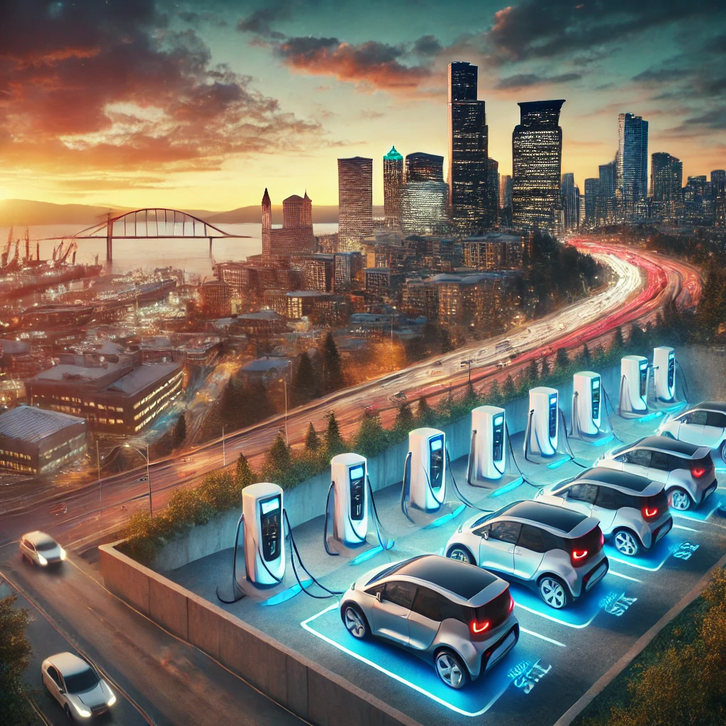
Motivation *Rapid growth of EV adoption. *Charging infrastructure is crucial for EV adoption. *Interest in sustainable technologies and clean energy transition.

Slide 5
What are the key factors for optimizing the distribution of EV charging stations in Washington?

Slide 7
• Which cities in Washington have the highest concentration of EVs, and how does this correlate with the availability of charging stations?

Slide 9
• How does the distribution of EV population and charging stations vary across cities in Washington?

Slide 10
• What are the optimal locations for charging stations in Washington based on traffic flow and population density?

Slide 12
• How many charging stations in Washington support fast charging (EV DC Fast Count), and where are they located?

Slide 13
Recommendations and Suggestions

Slide 14
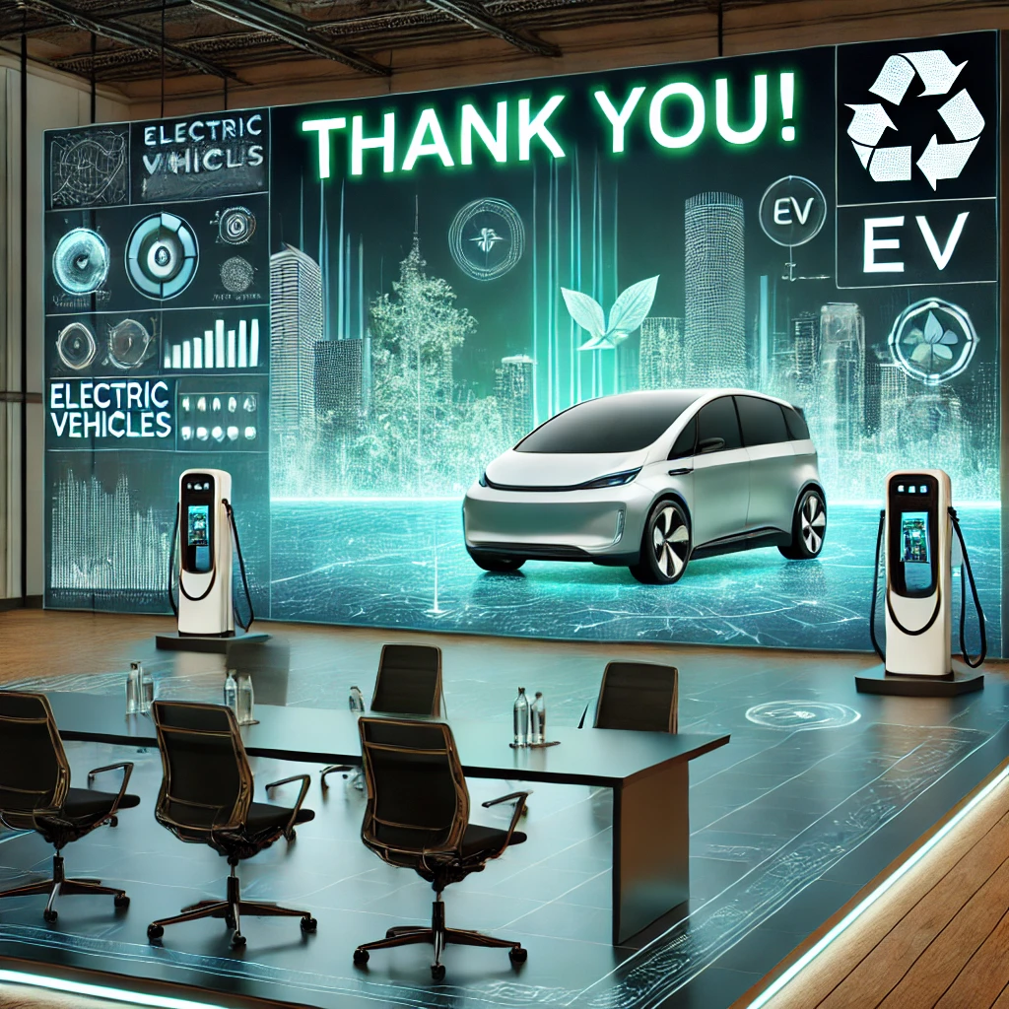
Thank you!

Slide 15
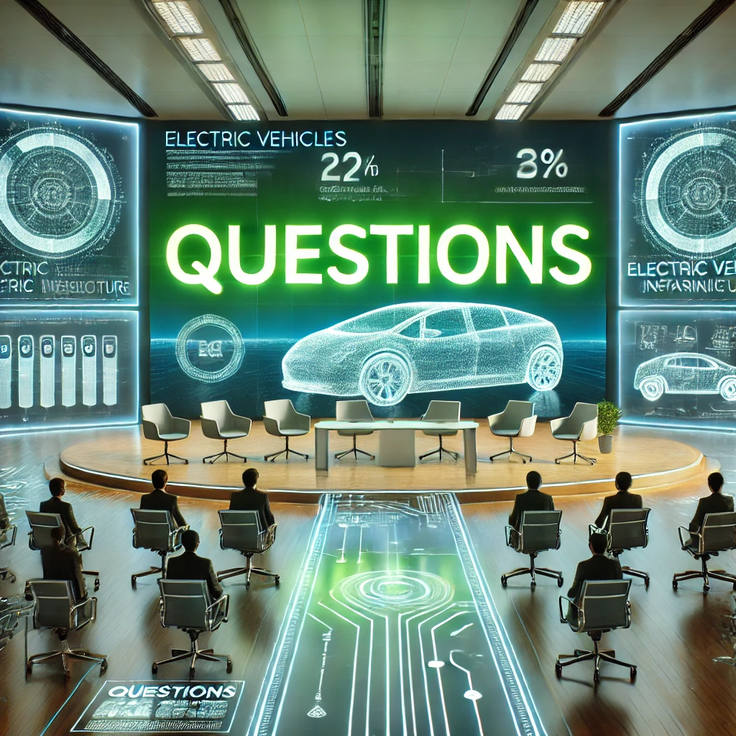
Questions?

